Slide 1
Introduction to Design
Thinking in Models
  Software systems are becoming increasingly complex and difficult
  to develop
  Today even small systems tend to exhibit increasing amounts of
  complexity

Slide 2
Introduction to Design
Thinking in Models
  We are continually striving to devise ways to attack complexity
  One such method is to develop models….
  …Using models
    We try to abstract away inessential details
    Focus on what's important

Slide 3
Introduction to Design
Thinking in Models
  Models are simplifications of a problem
    Simulations and emulations model real world processes
    Fantasy game program models an imaginary world

Slide 4
Introduction to Design
Tools for Modeling - Objects Revisited
  Objects are an abstraction … a model ….
  ...they encapsulate
    Data and functions
    Functions operate on the data

Slide 5
Introduction to Design
Models and Model Analysis
  A model is an abstract representation of a real world entity
    What makes a good model…..
      Must be simple
      Accurate
      Support abstraction
      Support refinement
      Extensible

Slide 6
System Design
Problem Solving
    Problem Statement
    Goal

Slide 7
Design
Concrete
Abstract
Application
Entities
Types
Objects
Solution
Classes

Slide 8

Definitions
      class YogurtTemp
      {
        float temp;
        float location;
      }

Slide 9
Definitions
From Booch
  Object Oriented Programming
    Co-operating Collection of Objects
  Object Oriented Requirements
    Understanding the uses and behaviour of the design
  Object Oriented Analysis
    Analyzes Requirements in the Vocabulary of the Problem Domain
  Object Oriented Design
    Design Encompassing Object Oriented Decomposition

Slide 10
System Design
Major Elements
Abstraction
Encapsulation
Modularity
Hierarchy
Minor Elements
  Typing
  Concurrency
  Persistency

Slide 11
System Design
Abstraction
  Focuses on
    The outside view of an object
    The observable behavior of the object
  Denotes
    Essential characteristics of an object

Slide 12
System Design
Encapsulation
  Complement to Abstraction
  Achieved Through Information Hiding
  Process of Compartmentalizing Elements of an Abstraction

Slide 13
System Design
Modularity
  Act of Partitioning a Program into Individual Components
  Modules Serve as Physical Containers
  Property of a System Decomposed into Loosely Coupled Modules

Slide 14
System Design
Modularity Considerations
  Modules Serve as Indivisible Units of Software
  Many Compilers Generate Object Code in Segments
  Work Assignments
  Rapidly Stabilize Module Interfaces
  Security

Slide 15
System Design
Hierarchy
  A Set of Abstractions Forms a Hierarchy
  Simplifies Understanding the Problem
  Ranking or Ordering of Abstractions

Slide 16

System Design
Kinds of Hierarchies
    Most Important
  IS-A
  HAS-A
  Supporting
  CREATES-A
  USES-A

Slide 17
System Design
Typing
  Type
    Precise Characterization of Structural and Behavioral Properties
  Typing
    Enforcement of the Class of an Object

Slide 18
System Design
Types
    Strong
      Type Conformance Enforced
      Violations Detected at Compile Time
    Weak
      Mix of Strong and No Type
    None
      Any Object can Send a Message to any Class
      Violations Usually Detected at Runtime

Slide 19
System Design
Typing and Binding
  Static Typing vs. Strong Typing
  Strong Typing
    Refers to Type Consistency
  Static Typing
    Refers to the Time Names are Bound to the Type

Slide 20
System Design
Static vs. Dynamic Typing
  Static Binding
    Early
    Types Fixed at Compile Time
  Dynamic Binding
    Late
    Types Determined at Runtime

Slide 21
System Design
Dynamic Typing
  Dynamic Binding and Polymorphism
    Single Name
      Denotes Objects of Different Classes
      Related by a Common Super Class

Slide 22
System Design
Concurrency
  Ability to Handle Different Events Simultaneously
    Heavyweight Processes
    Lightweight Processes
  Focuses on Process Abstraction and Synchronization

Slide 23

System Design
Concurrency
  Property that Distinguishes
Active Objects
Inactive Objects

Slide 24
System Design
Persistence
  Range
    Transient Appears in Expression Evaluation
    Local Variables
    Extent Different from Scope
    Exists Between Executions of the Program
    Exists Between Versions of the Program
    Outlives the Program

Slide 25
System Design
Persistence
Must be Concerned with
  The State of the Object
  The Class of the Object
Property of an Object Through Which its Existence Transcends
  Time
  Space
  Location

Slide 26
System Design
Getting Started
  Development of Systems Requires Knowledge About…
    Problem
    Tools and Techniques
    Methods

Slide 27
System Design
Life Cycle Models
  Independent of design methodology we have what we call a
  product life cycle
  A life cycle comprises necessary steps or processes
  necessary to execute a design using the methodology

Slide 28
System Design
Life Cycle Models
  The life cycle of the development of a system is
    A purely descriptive representation
    Breaks development process into series of interrelated activities
  Number of models have been suggested…all comprise
    Specification or Definition
    The Design
    The Implementation
    Manufacture
    Application to the Intended Problem

Slide 29
System Design
Life Cycle Models
  Several of historically more common
    Waterfall
    Contractual
    V cycle
    Spiral
    Rapid Prototype

Slide 30
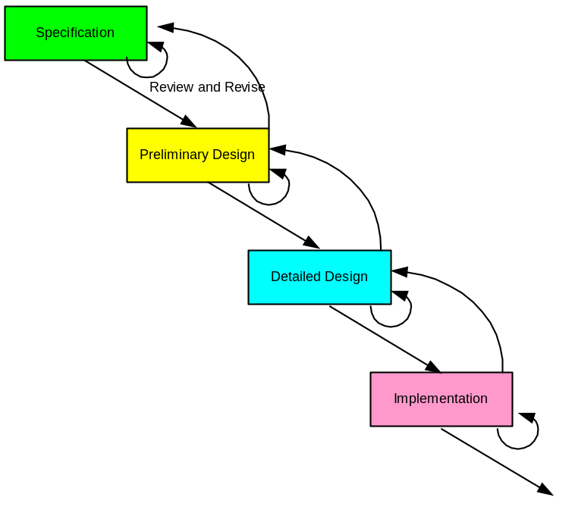
System Design
Waterfall Model
Represents cycle as a series of steps
  Specification → Specification Review
  Preliminary Design → Design Review
  Detailed Design → Design Review
  Implementation → Review

Slide 31
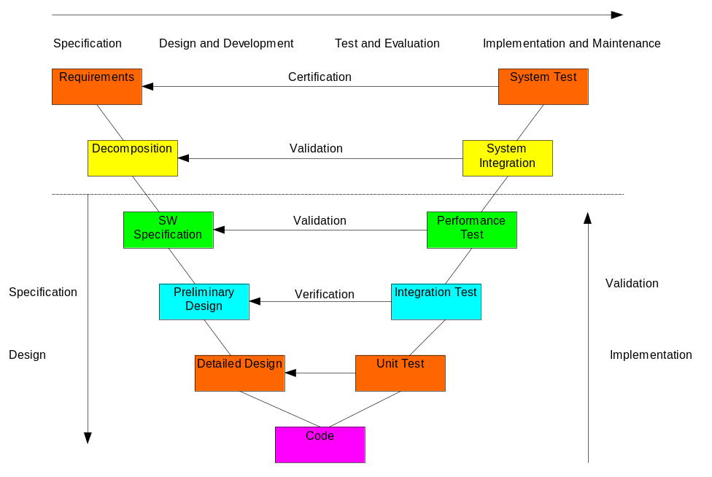
System Design
V Cycle
  Similar to the waterfall model
    Emphasizes the importance of addressing testing activities up front
    Associates the development activity with a test or validation at the same level

Slide 32
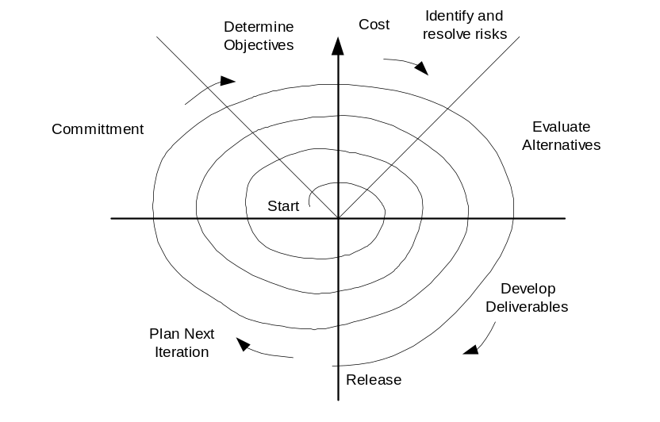
System Design
Spiral Model
  Each iteration involves six steps
    Determine objectives, alternatives, and constraints
    Identify and resolve risks
    Evaluate alternatives
    Develop deliverables-verify they are correct
    Plan the next iteration
    Commit to an approach for next iteration

Slide 33
System Design
Rapid Prototyping – An Incremental Approach
  Used to develop a quick implementation of software and hardware
  Allows developers to construct hardware and software in
  incremental stages
  Each stage adds additional functionality
  Each stage consists of design, code and unit test, integration test
  and delivery

Slide 34
System Design
Rapid Prototyping – An Incremental Approach
  The prototype is used several ways
    Developer
      Enables rapid development of major functionality of system
      Establishes structural architecture and flow of control
      Permits one to identify major problems early
    Customer
      Customer uses the prototype in a real world context
      Provides feedback to the
      Developers as to its strengths and weaknesses

Slide 35
System Design
Five Steps to Design
Good system designers and designs proceed using a minimum of five steps….
….and also consider
Requirements Definition
System Specification
Functional Design
Architectural Design
Prototyping
IP capitalization and reuse at every design stage
Traceability in both forward and reverse directions

Slide 36
System Design
Requirements Definition
  Process of understanding what the needs of all interested parties are
  Documenting these needs as written definitions and descriptions

Slide 37
System Design
Purpose of the Specification step is to
  Capture and express a purely external view of the system
  Identify WHAT needs to be done
  Develop a complete modeling of the system behavior

Slide 38
System Design
Design Specification
  Based upon the System Requirements Specification
  Specifies the how of the design not the what
  Written in the designer’s language
    From the designer’s point of view
  Serves as bridge between the customer and designer

Slide 39
System Design
Design Specification
  Requirements Specification
    Provides a view from the outside of the system looking in
  Design Specification
    Provides a view from the inside looking out as well

Slide 40
System Design
Design Specification
  Design Specification must
    Formalize requirements in precise, unambiguous language
    Should be clear, robust, and complete

Slide 41
System Design
Functional Design
  Purpose is to find an appropriate internal architecture
  for the system…..
  ….that explains the HOW the identified requirements
  are implemented according to an application-oriented
  viewpoint

Slide 42
System Design
Functional Design
  A first functional decomposition is carried out based
  upon a search of essential internal variables and events
  in the system
  The design process then consists of successive
  refinements or decompositions for each function

Slide 43
System Design
Architectural Design
  In executing an architectural design our goal is to define or develop the
  detailed solution
  Consists of searching...
    Firstly for an architecture
    Secondly for the mapping of each functional module onto the physical software module(s) or blocks

Slide 44
System Design
Prototyping
  The prototype phase leads to an operational system
  prototype
  Prototype implementation includes...
    Testing
    Debugging
    Validation

